Slide 1
Dashboard Infographics
Analysis of different brands and products.
1,800 k
2,300 k
6,300 k
FACEBOOK LIKES
WEB VIEWS
INSTAGRAM LIKES

Slide 2
Dashboard Infographics
Analysis of different brands and products.
Business professionals like you connecting.
Business professionals like you connecting.
Business professionals like you connecting.

Slide 3
Dashboard Infographics
Analysis of different brands and products.
INVESTMENT
SALES
PROFITS
INNOVATION
$962,437
$268,523
$650,567
$234,892
Business professionals like you connecting to share advice.
Business professionals like you connecting to share advice.
Business professionals like you connecting to share advice.
Business professionals like you connecting to share advice.

Slide 4
Dashboard Infographics
30%
50%
Analysis of different brands and products.
FACEBOOK
INSTAGRAM
AD Sales
AD Sales
$4M
$2.3M

Slide 5
Dashboard Infographics
73%
27%
Analysis of different brands and products.
Investment
Innovation
Business professionals like you connecting to share advice.
Business professionals like you connecting to share advice.
That’s why we provide point and click solutions.
68%
37%
Sales
Profits
Business professionals like you connecting to share advice.
Business professionals like you connecting to share advice.

Slide 6
Dashboard Infographics
Analysis of different brands and products.
1,600 k
FACEBOOK LIKES
FACEBOOK
2.34%
2,900 k
TWITTER
INSTAGRAM LIKES
4.92%
INSTAGRAM
6.53%
1,200 k
TWITTER FOLLOWS

Slide 7
Dashboard Infographics
Analysis of different brands and products.
1st Quarter
Business professionals like you connecting to share advice.
2nd Quarter
Business professionals like you connecting to share advice.
3rd Quarter
Business professionals like you connecting to share advice.
4th Quarter
Business professionals like you connecting to share advice.
30%
50%
70%
90%

Slide 8
Dashboard Infographics
10%
11%
Analysis of different brands and products.
55%
24%
That’s why we provide point and click solutions.
Financial Risk
Profits
Competitive Risk
Investment
Business professionals like you connecting.
Business professionals like you connecting.
Business professionals like you connecting.
Business professionals like you connecting.

Slide 9
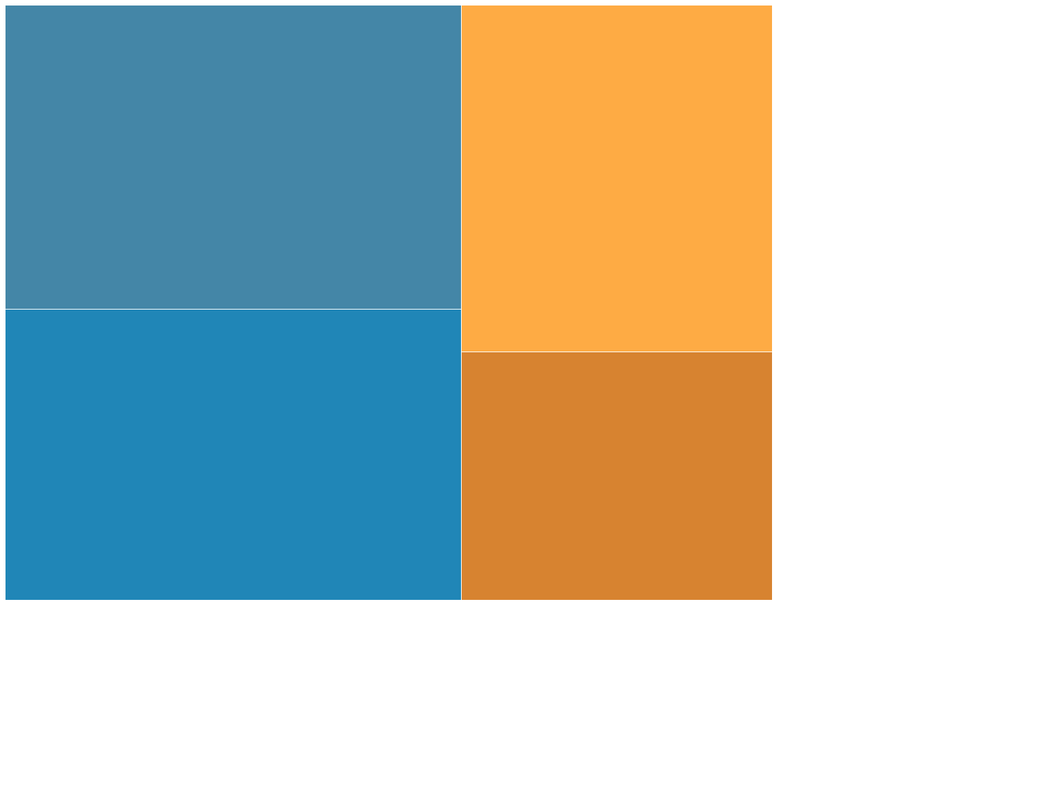
Dashboard Infographics
Analysis of different brands and products.
25%
25%
25%
24%
Business
Suppliers
Business professionals like you connecting to share advice.
Business professionals like you connecting to share advice.
24%
21%
25%
Community
Competitors
21%
Business professionals like you connecting to share advice.
Business professionals like you connecting to share advice.

Slide 10
Dashboard Infographics
Analysis of different brands and products.
Investment
Results
1st Q
3rd Q
$1M
$3M
2nd Q
4th Q
Profit
Results
$4M
$2M

Slide 11
Dashboard Infographics
Analysis of different brands and products.
01
Cash Flow
Business professionals like you connecting to share advice.
02
Investment
Business professionals like you connecting to share advice.

Slide 12
Dashboard Infographics
Analysis of different brands and products.
Investment
Inversion
Profits
Business professionals like you connecting to share advice.
Business professionals like you connecting to share advice.
Business professionals like you connecting to share advice.

Slide 13
Dashboard Infographics
Analysis of different brands and products.
1.8K
FACEBOOK
1.5K
INSTAGRAM
Business professionals like you connecting to share advice.
Business professionals like you connecting to share advice.
Likes
Follows

Slide 14
Dashboard Infographics
Analysis of different brands and products.
85%
01
02
10
100
That’s why we provide point solutions
Social Media
That’s why we provide point solutions
Business professionals like you connecting to share advice.
60%
Business professionals like you connecting to share advice.
10
100
Website

Slide 15
Dashboard Infographics
SOCIAL MEDIA
Analysis of different brands and products.
Twitter
Business professionals like you connecting to share advice, promotions only work as well.
Instagram
Business professionals like you connecting to share advice, promotions only work as well.
Facebook
Business professionals like you connecting to share advice, promotions only work as well.

Slide 16
Dashboard Infographics
Analysis of different brands and products.
1,500 k
35%
50%
FACEBOOK LIKES
4,100 k
1,996
2,641
INSTAGRAM LIKES
FACEBOOK
INSTAGRAM

Slide 17
Dashboard Infographics
Analysis of different brands and products.
You need to make sure you promote by business company.
Visits
Clients
Sales

Slide 18
Dashboard Infographics
Analysis of different brands and products.
Social media
Marketing is the study and management of exchange relationships.
Marketing
Social media
Marketing
Marketing is the business process of creating relationships with and satisfying customers.
25%
75%
40%
60%
Invest
Profit
Invest
Profit

Slide 19
Dashboard Infographics
Analysis of different brands and products.
Investment
Analysis
$3k
Marketing is the study and management of exchange relationships.
Profit
Analysis
$4k
Marketing is the business process of creating relationships with and satisfying customers.

Slide 20
Dashboard Infographics
Analysis of different brands and products.
Social Media
Marketing
There are people who have a significant number of followers in every business.
There are people who have a significant number of followers in every business.
1,670 k
3,960 k
25%
55%
INVESTMENT
PROFIT
INVESTMENT
PROFIT

Slide 21
Dashboard Infographics
Analysis of different brands and products.
40%
60%
Store A
Store B
Visits
Business professionals like you connecting to share advice.
Business professionals like you connecting to share advice.
Clients

Slide 22
Dashboard Infographics
Analysis of different brands and products.
85%
50%
10
100
INVESTMENT
SOCIAL MEDIA
OVERVIEW
That’s why we provide point and click solutions.

Slide 23
Dashboard Infographics
Analysis of different brands and products.
Business System
Business professionals like you connecting.
Suppliers
Business professionals like you connecting.

Slide 24
Dashboard Infographics
Analysis of different brands and products.
Product A
Product A
1st Half
1st Half
$2M
$3M
2nd Half
2nd Half
$3M
$1M

